Slide 1

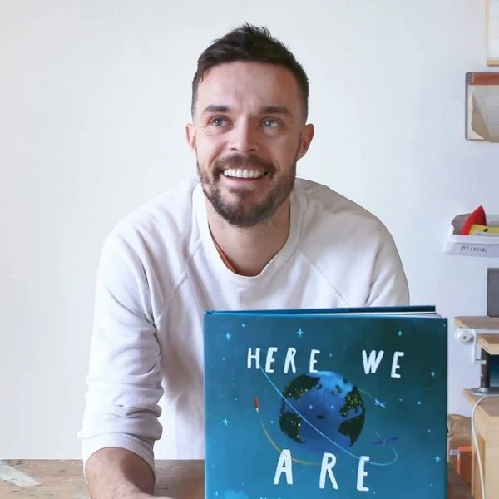
Writing Area/Message Centre
Insert real career photograph here
We can be :
  An Author
  A Journalist
  A Teacher
  A Screenwriter

Slide 2
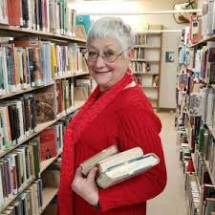
Reading Area – Careers
We can be :
  A Librarian
  A Editor
  A Storyteller
  A Publisher
Insert real career photograph here

Slide 3

Maths Area – Careers
We can be:
  An Accountant
  An Engineer
  A Data Analyst
  An Architect
  A Banker
Insert real career photograph here

Slide 4
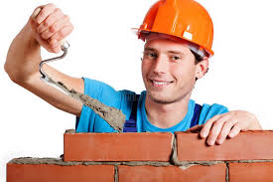
Construction Area – Careers
We can be:
  A Builder
  A Civil Engineer
  An Architect
  A Joiner
  A Carpenter
Insert real career photograph here

Slide 5
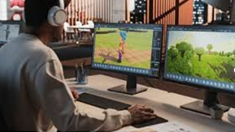
Small World – Careers
We can be a :
  A Film Director
  A Game Designer
  An Author
  A Story teller
Insert real career photograph here

Slide 6
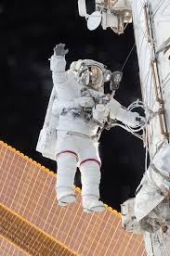

Role Play – Careers
We can be a:
  A Chef
  A Doctor
  A Nurse
  A Vet
  A Shop keeper
  An Astronaut
  A Teacher
  An Explorer
  A Marine Biologist
  A Bus Driver
  A Train Driver
Insert real career photograph here

Slide 7
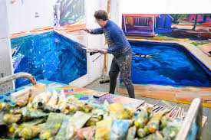
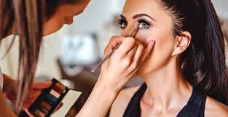
Creative Area– Careers
We can be a:
  An Artist
  A Graphic Designer
  A Fashion Designer
  An Illustrator
  An Animator
  A Sculpture
  A Graffiti Artist
  A Painter and Decorator
  A Makeup Artist
  A Nail Technician
  A Tattoo Artist
  A Seamstress
  An Event organiser
Insert real career photograph here

Slide 8
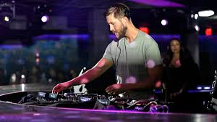

Music Area – Careers
We can be:
  A Musician
  A DJ
  A Composer
  A Sound Engineer
  A Music teacher
  A Performer
  A Celebrity
  A Singer
  A Dancer
Insert real career photograph here

Slide 9

Investigation Area
We can be:
  A Scientist
  A Biologist
  A Chemist
  A Lab Technician
Insert real career photograph here

Slide 10
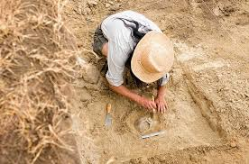
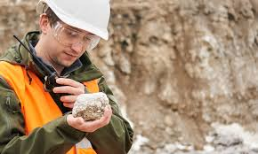
Sand Area – Careers
We can be:
  A Geologist
  An Archaeologist
  A Builder
  A Landscape Designer
Insert real career photograph here

Slide 11
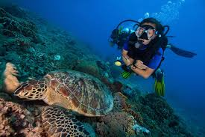

Water Area – Careers
We can be :
  A Marine Biologist
  A Oceanographer
  A Plumber
  A Lifeguard
  A Professional swimmer
Insert real career photograph here

Slide 12
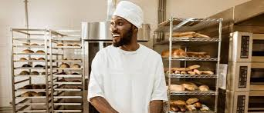
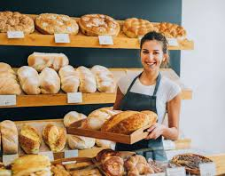
Malleable / Playdough Area – Careers
We can be:
  A Sculptor
  A Potter
  A Baker
  A Product Designer
Insert real career photograph here

Slide 13
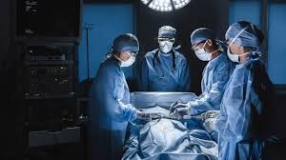

Fine Motor Area – Careers
We can be:
  A Surgeon
  A Jeweller
  A Dentist
  A Watchmaker
Insert real career photograph here

Slide 14
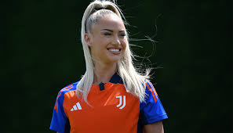
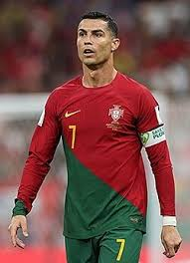
Gross Motor / Outdoor – Careers
We can be:
  An Athlete
  A PE Teacher
  A Physiotherapist
  A Coach
  A Footballer
  A Dancer
  A Gymnast
Insert real career photograph here

Slide 15
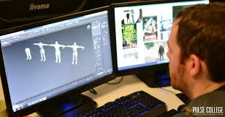
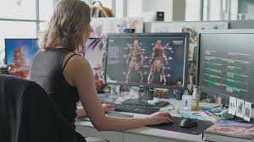
Technology Area – Careers
We can be:
  A Programmer
  A Game Developer
  An IT Technician
  A Robotics Engineer
  A Youtuber
  An Influencer
Insert real career photograph here

Slide 16
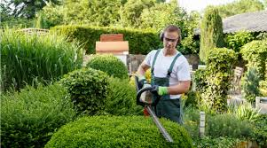
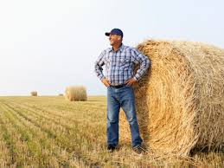
Gardening Area – Careers
We can be:
  A Gardener
  A Botanist
  A Farmer
  A Landscape Architect
Insert real career photograph here

Slide 17
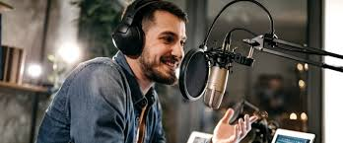
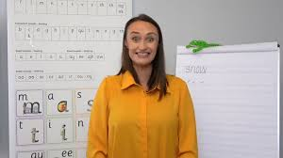
Phonics Area – Careers
We can be:
  A Speech Therapist
  A Teacher
  An Actor/Actress
  A Radio Presenter
  A News reader
  A TV Presenter
  The next Ruth Miskin!
Insert real career photograph here

Slide 18
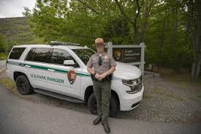
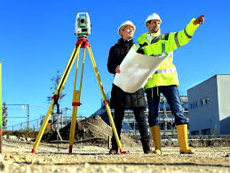
Outdoor Learning Area – Careers
We can be:
  A Park Ranger
  An Ecologist
  A Forestry Worker
  A Surveyor
  A Tree Surgeon
Insert real career photograph here

