Slide 1


Brookfield Junior Academy
Personal Development

Slide 2

Personal Development Overview
Our curriculum extends far beyond the academic, to allow pupils to develop in many diverse aspects of life.
This is encapsulated in our Personal Development
Curriculum.
We aim to ensure that, over their time at Brookfield Primary Academy, learners receive a Personal Development programme that gives them the knowledge that they need to make decisions, to strengthen them personally and to allow them to develop their character and personality.
We provide these rich experiences in a coherently planned way, in the curriculum and through extra-curricular activities.

Slide 3
Personal Development Overview
At Brookfield, there are four key drivers that underpin our Personal Development approach:
Healthy & safe behaviours
Awareness of the world
Character development
British Values

Slide 4
Personal Development Overview
Healthy & safe behaviours include our PSHE curriculum, Relationship Education, Sex Education, Physical Health, Mental Wellbeing and Wider Aspects of Safety.
Awareness of the world includes Economic Understanding, Understanding Media and Technology and Spiritual, Moral, Social and Cultural development, the Global Curriculum.
Character development includes development of children’s own character and personality, children’s behaviour and wider opportunities for children to engage with.
British Values includes Democracy, Rule of Law, Respect & Tolerance and Individual Liberty.

Slide 5
Focus for Personal Development: Creating Well-Rounded Pupils Ready for Society
At Brookfield Primary Academy, our aim is to provide every child with the knowledge, skills, and experiences to thrive as confident, respectful, and responsible members of society. Personal development underpins our whole-school ethos and ensures pupils leave us as well-rounded individuals prepared for the next stage of education and beyond.

Slide 6
Key Areas of Focus:
Character Education: Developing resilience, independence, and empathy through classroom practice, enrichment opportunities, and the wider curriculum.
Cultural Capital: Broadening horizons with experiences such as educational visits, visitors, and themed weeks to expose pupils to the wider world.
Values and Citizenship: Embedding British Values, respect for diversity, and responsibility to the community within assemblies, PSHE, and everyday school life.
Healthy Lifestyles: Promoting physical and mental wellbeing through PE, outdoor learning, mindfulness, and targeted support where needed.
Pupil Voice: Providing children with leadership opportunities (e.g., school council, eco leaders, playground buddies) to encourage responsibility and active participation in school life.

Slide 7
Impact:
Pupils demonstrate resilience, independence, and kindness in school and beyond.
Pupils develop awareness of different cultures, communities, and perspectives.
Pupils take pride in their achievements and show readiness for their next stage of education.
Pupils are equipped with the values, confidence, and skills to contribute positively to society.

Slide 8
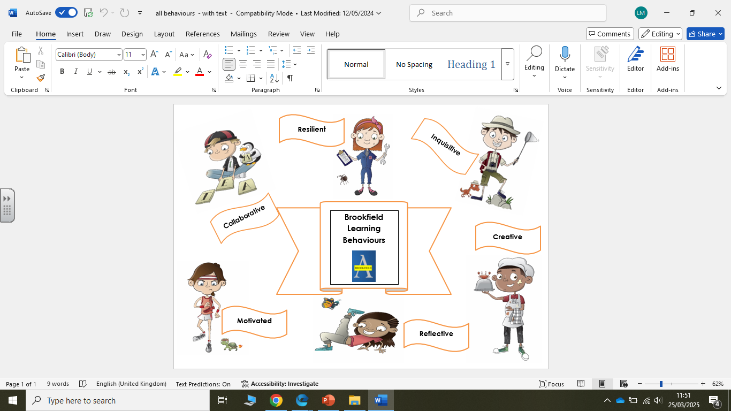
Building Better Learners
6 Identified learning behaviours:
Inquisitive
Reflective
Collaboration
Motivated
Creative
Resilience
Behaviours taught explicitly and clear progression from Nursery to Year 6.
Behaviours referred to and embedded into daily lessons and life of school
Important for successful learning and successful adults in the working world.

Slide 9

Our Core Values
Brookfield’s core values of Success, Pride, Ambition, Respect and Kindness were agreed in consultation with pupils, parents and staff. These values underpin the school’s approach to personal development and are embedded consistently across school life.
The school promotes Success by encouraging pupils to achieve well academically and personally, and by fostering resilience and a positive attitude to learning. Pride is developed through high expectations for behaviour, presentation and contribution to the school community. Ambition is evident in the school’s culture of high aspirations, where pupils are encouraged to set goals and strive for their best.
Respect is a central feature of the school’s ethos and is reflected in positive relationships between pupils and adults, as well as pupils’ understanding of diversity and difference. Kindness supports pupils’ emotional wellbeing and contributes to a safe, inclusive environment in which pupils feel valued and supported.
Collectively, these values contribute effectively to pupils’ personal development and prepare them well for the next stage of their education.

Slide 10
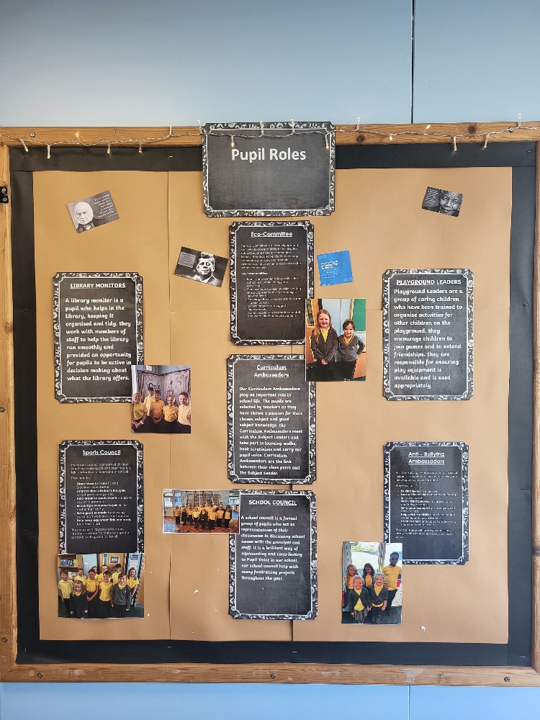
Pupil Leadership
At Brookfield Primary Academy, we believe it is essential to nurture the pupil voice and develop leadership skills among our children. We offer a variety of pupil leadership roles across the school, with some positions elected by peers and others nominated by staff.
Certain roles require pupils to apply formally by completing an application form and delivering a presentation, helping them to develop key skills such as communication, organisation, and self-confidence. These experiences not only empower pupils to make a positive contribution to school life but also provide valuable insight into the skills and processes involved in applying for jobs in the future.
Through these leadership opportunities, our pupils learn responsibility, teamwork, and the importance of having a voice within their school community.

Slide 11
Pupil Voice & Leadership
Role | Purpose | Process | Impact
School Council | Represent the views of pupils, contribute to decision-making, and improve school life | Pupils are elected by their class; hold regular meetings to discuss school issues and initiatives | Pupils feel their voice is valued, contribute to school improvements, and develop leadership skills
Anti-Bullying Ambassadors | Promote a safe, respectful, and inclusive school environment | Pupils are nominated or apply; receive training and lead awareness campaigns, support peers | Reduced incidents of bullying, pupils feel safer, and awareness of kindness and empathy is raised
Librarians | Support the smooth running of the library and encourage a love of reading | Pupils apply or are selected; help organise books, assist peers, and manage borrowing | Increased library use, improved reading engagement, and responsibility in pupils
Playground Leaders | Promote positive play and support pupils in resolving minor conflicts | Pupils apply or are nominated; lead games, support peers, and promote fair play | Safer, happier playground; pupils develop leadership, problem-solving, and social skills

Slide 12
Pupil Voice & Leadership
Role | Purpose | Process | Impact
Curriculum Ambassadors | Provide pupil perspective on curriculum development and learning experiences | Pupils are selected to represent classes in discussions with staff | Feedback improves teaching and learning; pupils feel involved in shaping their education
With Me in Mind Ambassadors | Promote mental health and wellbeing, support peers, and create a positive school environment | Pupils are nominated; receive training and lead initiatives or campaigns on wellbeing | Increased awareness of mental health, pupils feel supported, and a nurturing school culture is developed
Sports Council | Organise sports events, promote physical activity, and represent pupils’ sporting interests | Pupils are elected; plan events, lead initiatives, and liaise with staff | Increased participation in sports, improved teamwork and organisation skills, pupil voice in sports provision
Eco Council | Promote environmental awareness and sustainability across the school | Pupils apply or are nominated; lead eco projects and campaigns | Greener school environment, pupils develop responsibility and awareness of sustainability issues

Slide 13
SEND
At Brookfield Primary Academy, we are deeply committed to ensuring that all pupils with Special Educational Needs and Disabilities (SEND) are fully included in every aspect of school life. Pupils with SEND play an active role in shaping their own development through meaningful involvement in their Education, Health and Care Plans (EHCPs), regular monitoring meetings, and opportunities for pupil leadership.
We ensure that every child has access to the full breadth of the curriculum and the wider opportunities available at our school, including enrichment, clubs, trips, and leadership roles. Where needed, personalised timetables and targeted support are provided to enable each pupil to thrive academically, socially, and emotionally.
Through this inclusive approach, we celebrate the unique strengths and talents of every learner, fostering confidence, independence, and a strong sense of belonging within the Brookfield community.

Slide 14


PREM AWARENESS
At Brookfield Primary Academy, we are proud to be a Prem Aware school. All staff have received training to understand the potential impact of prematurity on children’s development and learning. This knowledge enables us to provide informed, sensitive, and tailored support to meet each child’s individual needs.
We actively encourage parents and carers to share any relevant information about their child’s early experiences, including premature birth, so that we can work together to ensure the best possible outcomes. By building strong partnerships between home and school, we aim to create an environment where every child feels understood, supported, and able to reach their full potential.

Slide 15
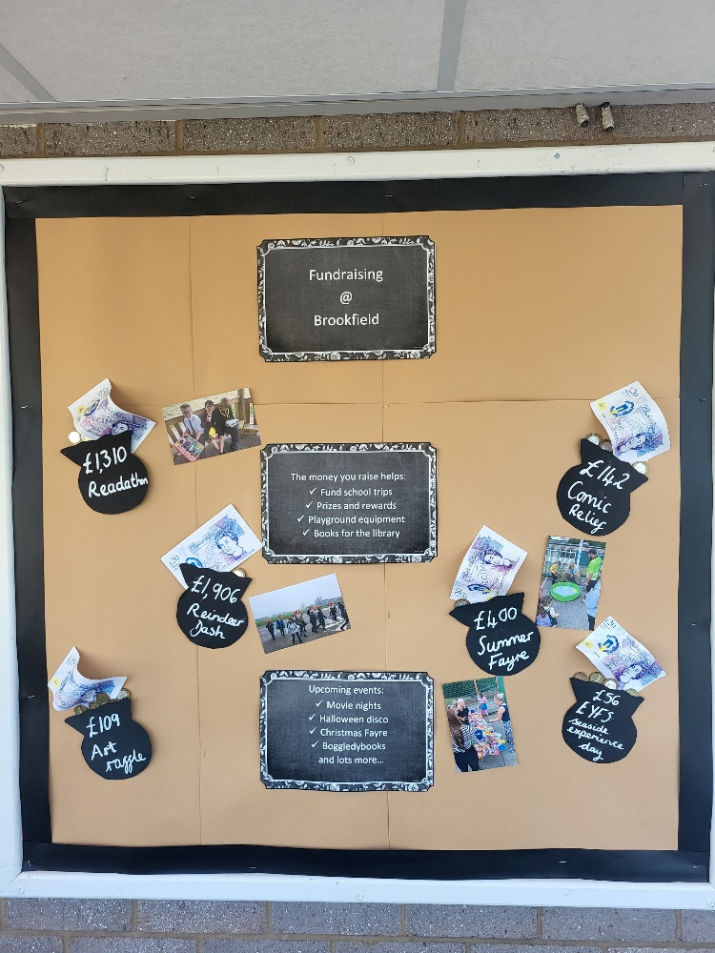
Fundraising
Fundraising plays an important role in our primary school, both in supporting our community and teaching children the value of helping others. Through activities such as Harvest donations, Remembrance Sunday merchandise, Comic Relief, Children in Need, and local initiatives like the Reindeer Dash for Rotherham Hospice, children learn about charity, empathy, and making a difference for those less fortunate. Fundraising also helps enhance our school resources, supporting events like summer and Christmas fayres, raffles, and art competitions, giving children opportunities to engage creatively while contributing to the life of the school.

Slide 16
Personal Development Curriculum Overview
Aspect of Personal Development | Wider school curriculum | Discrete PD
Safe behaviours Including; relationships education, sex education, physical health, mental well-being. Wider safety | RSHE curriculum PE Curriculum Computing Curriculum Science curriculum | Anti-bullying Week – November E-safety day – February Sun, Road, Water and Railway safety Bikeability Training Dental Visits, Flu Jabs Crucial Crew Feel Good Friday
Awareness of the world Including economic understanding, understanding media and technology, spiritual, moral, social, and cultural | RSHE curriculum RE/Music/Art/Geography/Science curriculum Visits and Visitors | Assembly Programme Y4 Skills Street Visit Y6 STEM Day @ Magna Crucial Crew – Y6 Visits to the local Church Careers week UKS2 Young Voices
Character Including; development of character, confidence and resilience, citizenship, wider opportunities | RSHE curriculum Extra- Curricular provision Music programme Whole school performances Reward assemblies | Brookfield Learning Behaviours Residential trip – Year 6 Assembly programme Pupil Voice Roles, Curriculum Ambassadors Playground Leaders Library monitors, Corridor Monitors Feel Good Friday Y2 Pops Trip
Values Including; democracy, rule of law, respect and tolerance, individual liberty, citizenship | RSHE curriculum RE/History curriculum | Assembly programme Remembrance day – November

Slide 17
Personal Development Specific Assemblies
Theme | Autumn | Spring | Summer
Aspiration | Values Manifesto Aspirations and targets
Diversity – Equality | Similarities and difference Human Rights Poverty Fairtrade Black History Month National Languages Day | Inclusion Mother Language Day International Women’s Day Families – committed relationships
Safety | Road Safety | Safer Internet Day | Stranger Danger Water Safety
Citizenship | Huan Rights Poverty Fair Trage ECO Code |  | Planet Protectors Earth Day Caring for Seas and Oceans
Values | Aspirations Courage Responsibility Respect Care and Support British Values | Caring and responsibility

Slide 18

Theme | Autumn | Spring | Summer
Learning Behaviours | Resilience Collaboration Creative Inquisitive Motivated Reflective | Resilience Collaboration Creative Inquisitive Motivated Reflective | Resilience Collaboration Creative Inquisitive Motivated Reflective
Mental Health and Well-Being | Happy, health friendships | Mental Health week | Healthy Body, Healthy Mind Keeping Healthy – Freddy Fit Coping with change
Cultural/Moral | Harvest Bonfire Night Children in Need Diwali Hannukah | Comic Relief Sports Relief | Art week

Slide 19
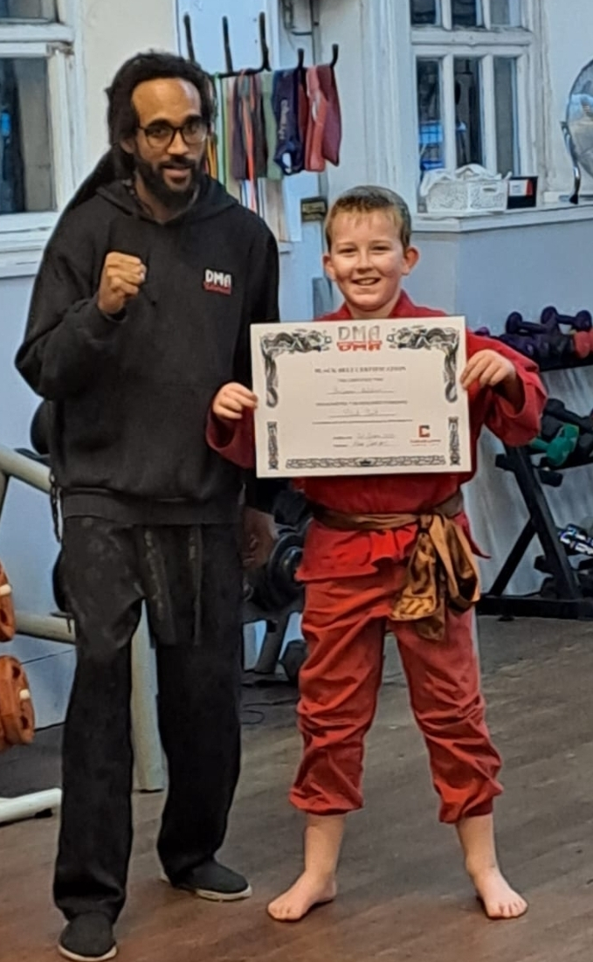


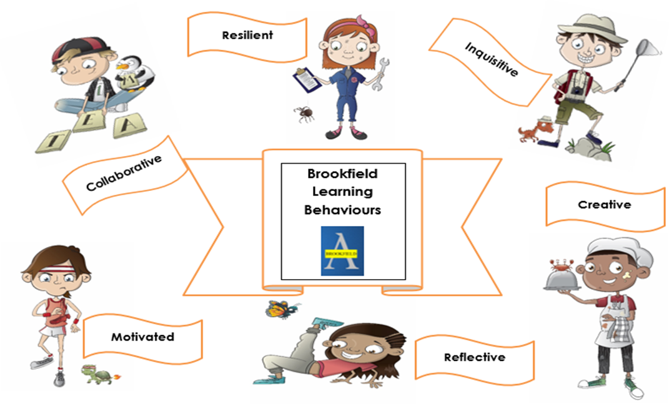
Celebration Assemblies
At Brookfield Primary Academy, we use themed assemblies delivered by staff and visitors to inspire, motivate, and celebrate our pupils. On Motivational Monday, assemblies focus on encouraging pupils to have a successful week ahead, ending with the children singing our school song, “Proud”, to foster a sense of unity and pride.
On Friday, our rewards assembly recognises and celebrates pupils’ achievements, both inside and outside of school. Awards include Pupil of the Week, Focus Learning Behaviour, Reading Stars, and the Staff Excellence Award. Attendance and punctuality are also celebrated, with pupils reminded of their targets and encouraged to attend school every day.
Achievements beyond the classroom are equally valued; children are invited to share trophies, certificates, and other personal accomplishments, helping to nurture confidence, self-esteem, and a culture of pride in personal success.

Slide 20
RSHE
Through our RSHE scheme pupils will develop:
the knowledge, skills and attributes they need to keep themselves healthy and safe, and prepared for life and work.
an understanding of friendships and how to keep friendships positive and healthy.
an understanding of their own values and identity and skills to resolve difficulties, including maintaining and respecting personal boundaries and safe touch.
knowledge and understanding of similarities and differences and encouraging ways to value and respect difference and diversity.
their understanding and gratitude for special people in their lives. Pupils will be aware of increasing responsibilities towards themselves, including the role they can play and the difference they can make within their communities.
their understanding of diversity of families and the characteristics of healthy, positive family relationships.
Knowledge of how to stay healthy, both physically and mentally, maintain wellbeing and prevent illness.
An understanding of how people grow and change from babies, through puberty to adulthood.
With Me In Mind – we offer a variety of workshops to key pupils who would benefit from sessions on self- esteem, friendships, anxiety and many other areas of the RSHE curriculum.

Slide 21
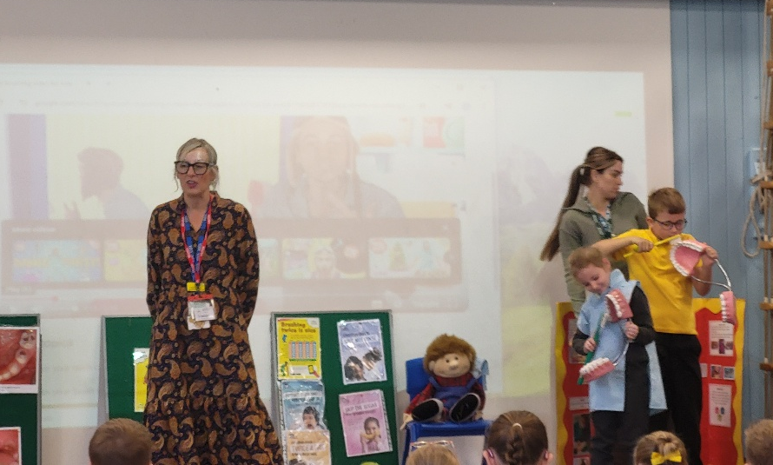
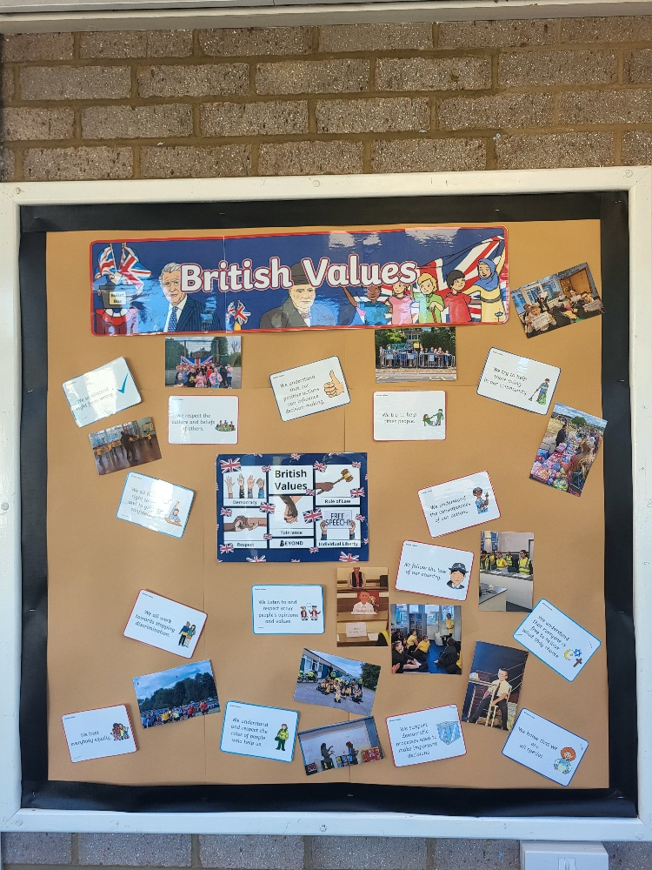
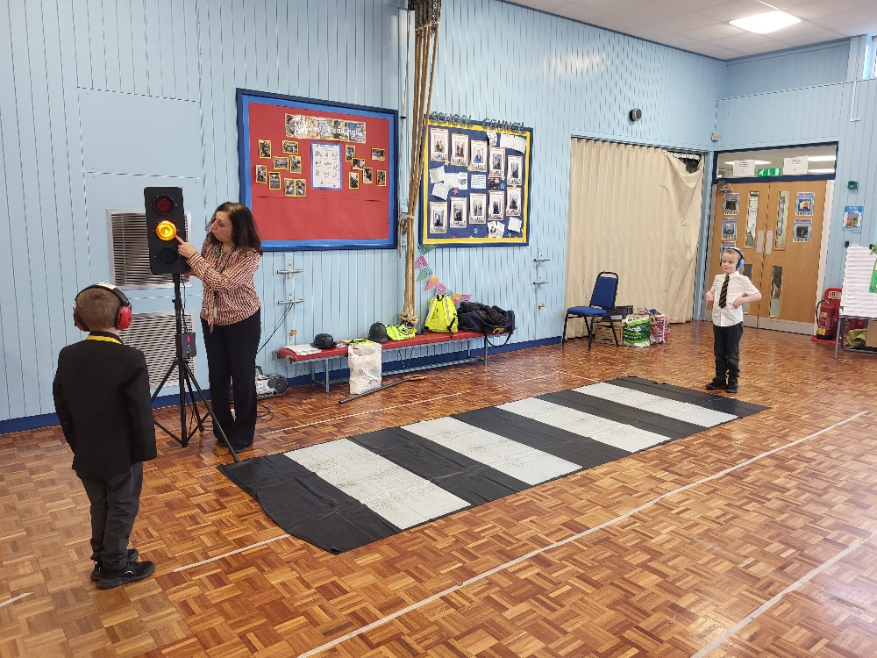
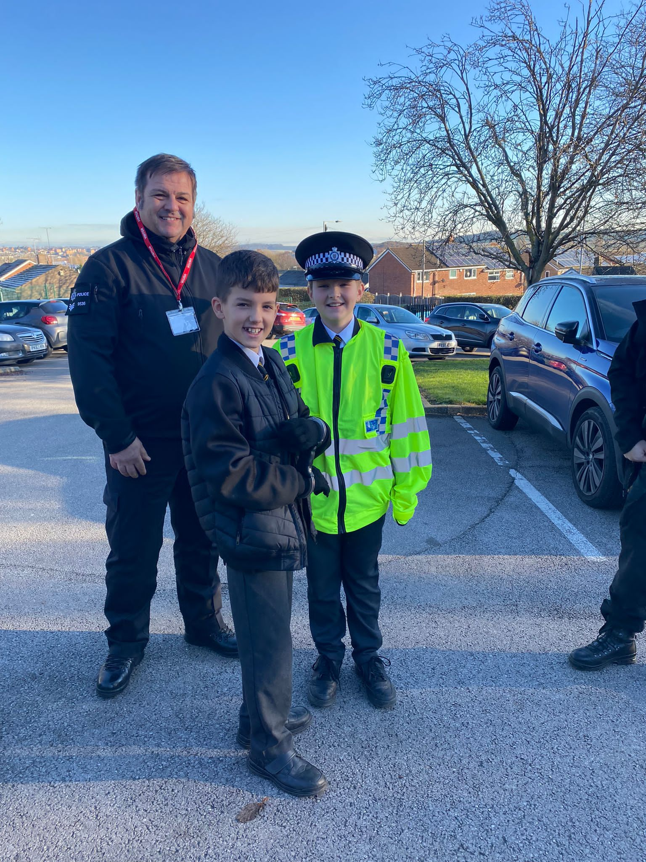

Slide 22
Aspiration and Careers Education
At Brookfield Primary Academy, we believe in nurturing the whole child — developing confident, ambitious, and well-rounded learners who are equipped with the knowledge, skills, and values they need to succeed
in modern Britain. As part of our personal development provision, we recognise the importance of preparing children for life beyond school, including raising aspirations and providing meaningful opportunities to learn about the world of work.
Aims:
To develop a comprehensive, age-appropriate careers and employment curriculum that introduces children to a wide range of career paths and opportunities.
To raise aspirations for all pupils by providing inspiring, relevant, and engaging experiences that help them understand the possibilities available to them in the future.

Slide 23
Aspiration and Careers Education
Aims:
To ensure children understand the value of learning, resilience, and ambition in achieving personal and career goals.
To build partnerships with local businesses, further education providers, and community organisations, offering pupils authentic insights into different professions.
To embed careers-related learning across the curriculum, linking classroom topics to real-world contexts wherever possible.
To promote equality of opportunity, ensuring that all pupils — regardless of background or starting point — are encouraged to be ambitious and explore a variety of career options

Slide 24
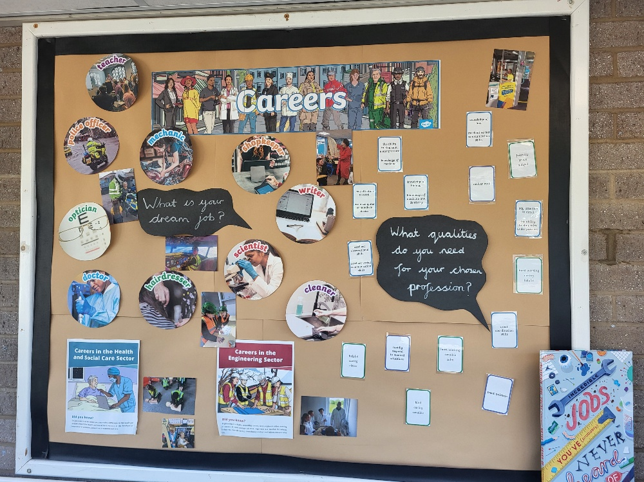
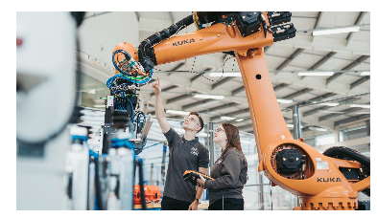
Careers and Education
Aspiration and Careers Education at Brookfield
 | Visitors/experiences | Whole school
EYFS | Ambulance Nurse | Special assemblies – RUFC Professional sports people Live author events online Sharing careers through Foundation subjects Share aspirational stories Singer
Year 1
Year 2
Year 3
Year 4 | Visit Skills Street
Year 5 | Careers day NHS day
Year 6 | Careers day . NHS day STEM day Theatre workshop skills University of Sheffield AMRC training centre

Slide 25
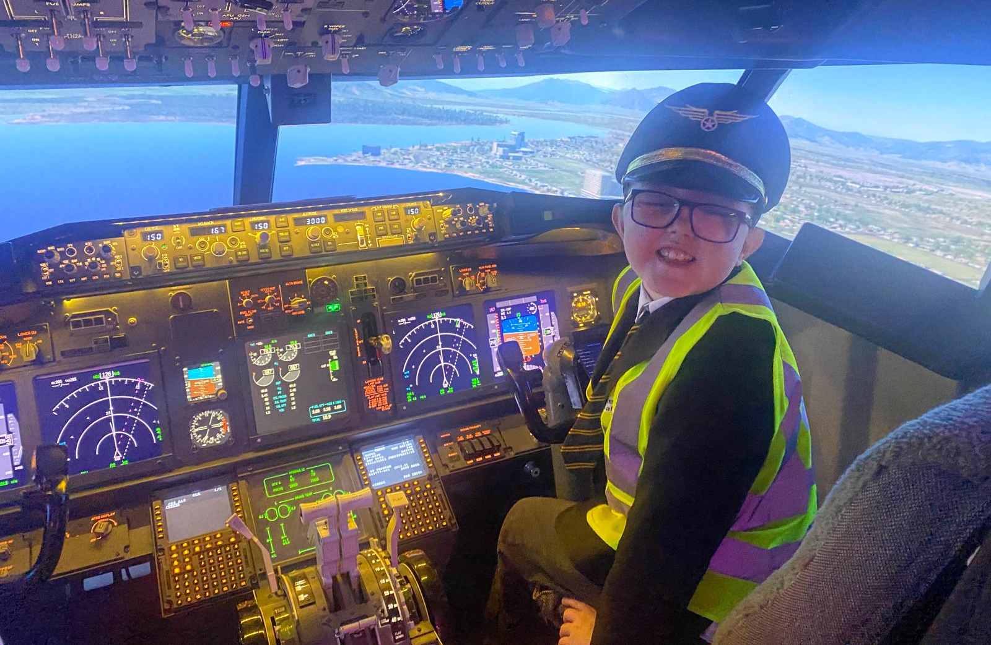
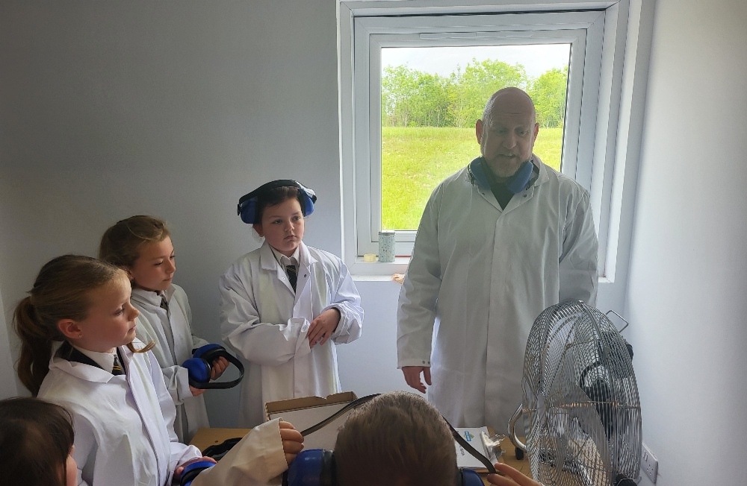
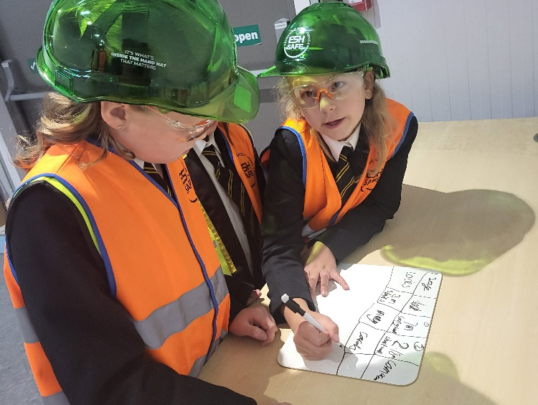
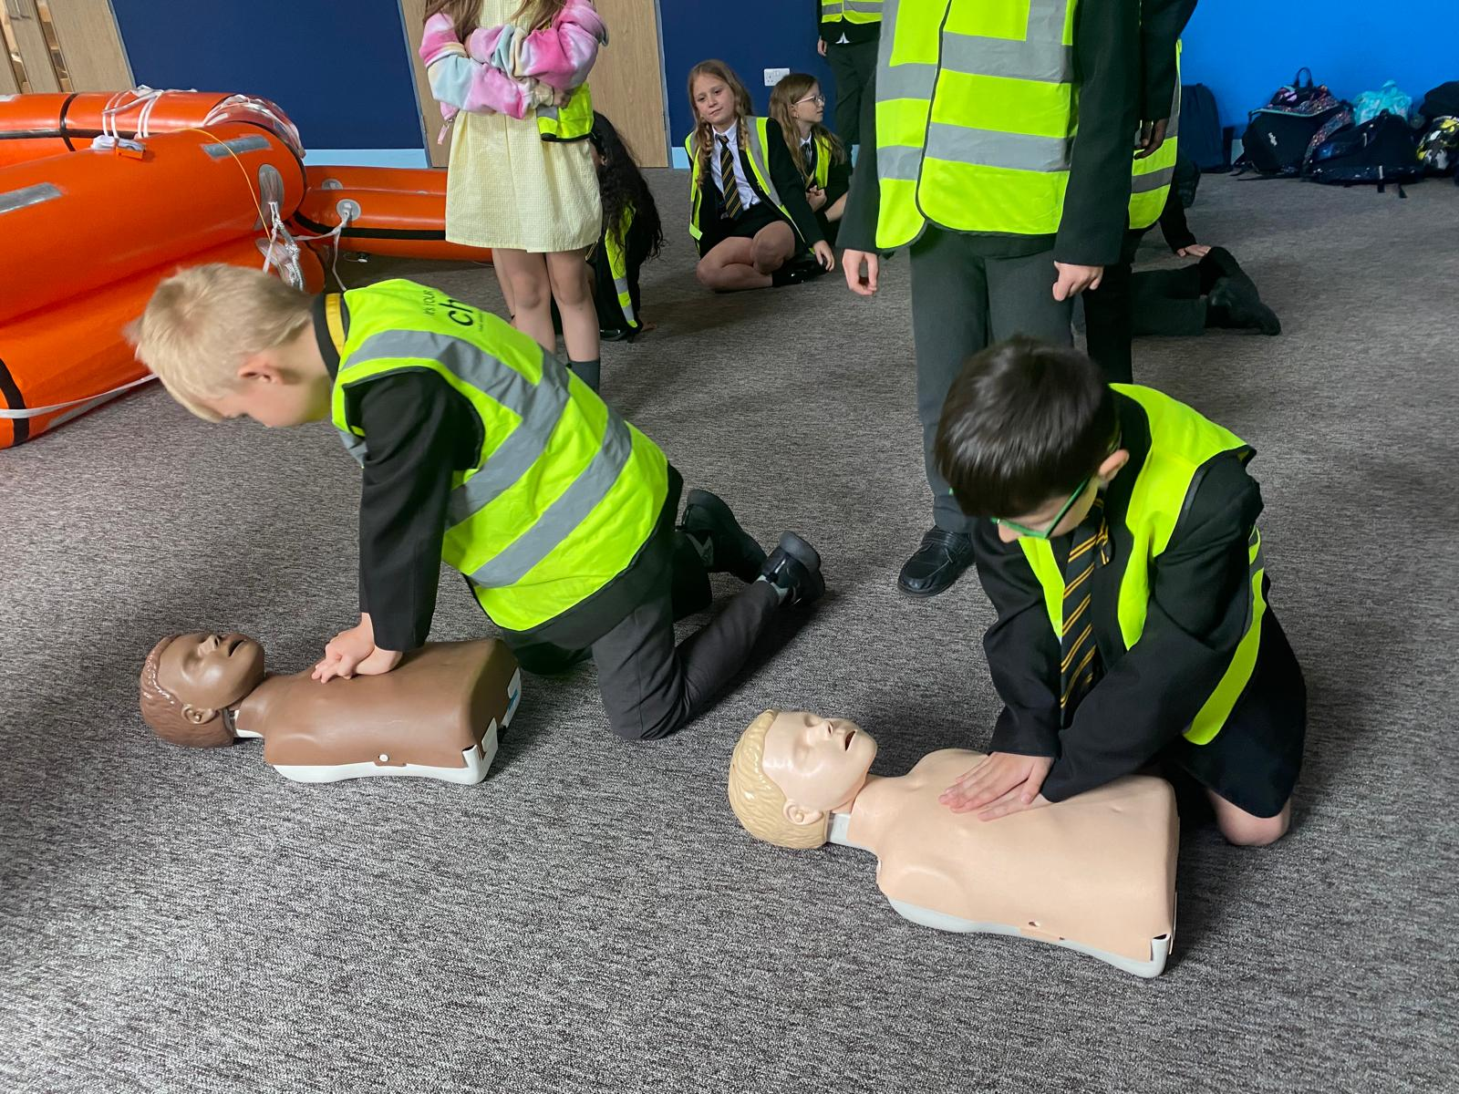
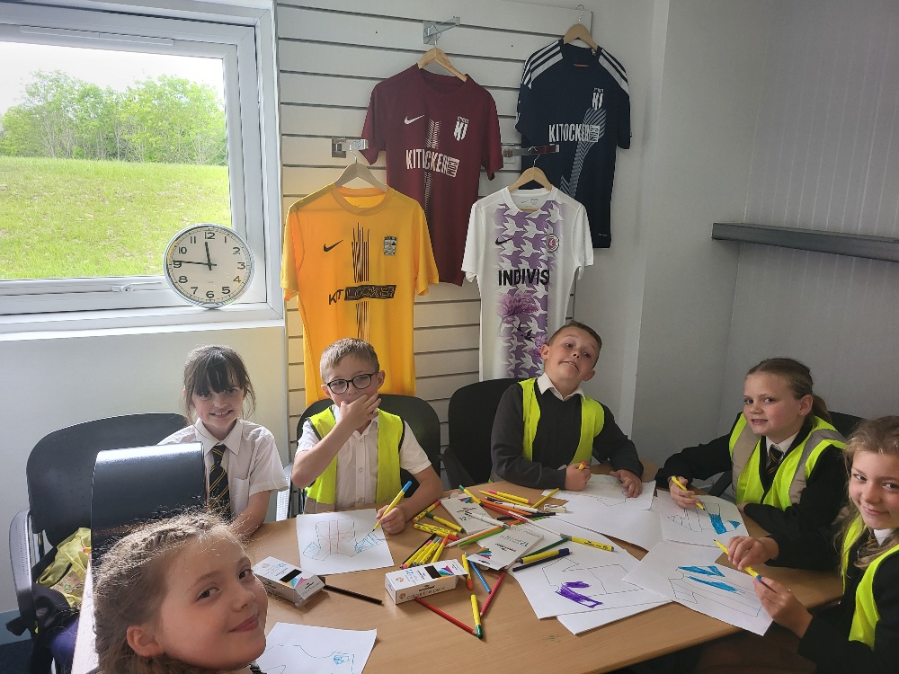

Slide 26
















Aspiration Texts
Class | Cycle A | Cycle B
Nursery | The Koala Who Could | Stuck
Reception | The Wonderful Things You Will Be | Me Jane…
Year 1 | Mae Among The Stars | How To Catch A Star
Year 2 | Giraffes Can’t dance | The Koala Who Could
Year 3 | Emmanuel’s Dream | Ish
Year 4 | Dare the Wind | The Lion Inside
Year 5 | Nothing Stopped Sophie | The Most Magnificent Thing
Year 6 | Manji Moves A Mountain | Colourful Dreamer

Slide 27
Focus Individuals – Yorkshire - Aspiration
Class | Curriculum | Creative Arts | Science | Sport | Humanities
Nursery |  | Def Leppard Soft Cell Human League Pulp ABC Robert Palmer Beautiful South Joe Cocker Artic Monkeys Zayn Louis Tomlinson Richard Halwy Elaine Page Yungblood Pete Mckee – artist Henry Moore – Sculpture David Hockney – sculpture | Sophie Wilson Kenneth Murray Bernard Kettlewell Helen Sharman | Geoff Boycott Jessica Ennis-Hill Kevin Keegan Beryl Burton Rob Burrow Darren Gough Nicola Adams James Milner David Seaman | David Hey Bernard Jennings Guy Fawkes
Reception | Guy Fawkes
Year 1
Year 2
Year 3
Year 4
Year 5 | Henry Moore
Year 6

Slide 28
Themed Days and Themed Weeks
Class | Autumn 1 | Autumn 2 | Spring 1 | Spring 2 | Summer 1 | Summer 2
Nursery | Harvest Collection | Anti-bullying week Children In Need | Chinese New Year Internet safety Day Comic Relief | Easter competitions | Arts Week | Sports week
Reception | Campaign Week Harvest Collection | Anti-bullying week Children In Need | Chinese New year Internet safety Day Comic Relief | Easter competitions | Arts Week | Sports week
Year 1 | Black History Month Harvest Collection | Anti-bullying week Children In Need | Chinese New year Internet safety Day Comic Relief | Easter competitions | Arts Week | Sports week
Year 2 | Black History Month Harvest Collection | Anti-bullying week Children In Need | Internet safety Day Comic Relief | Easter competitions | Arts Week | Sports week
Year 3 | Black History Month Harvest Collection | Anti-bullying week Children In Need | Internet safety Day Comic Relief | Easter competitions | Arts Week | Sports week
Year 4 | Black History Month Harvest Collection | Anti-bullying week Children In Need | Internet safety Day Comic Relief | Easter competitions | Arts Week | Sports week
Year 5 | Black History Month Harvest Collection | Anti-bullying week Children In Need | Internet safety Day Comic Relief | Easter competitions | Arts Week | Careers Fair Sports week
Year 6 | Black History Month vest Collection | Anti-bullying week Children In Need | Internet safety Day Comic Relief | Easter competitions | Arts Week | Careers Fair Sports week

Slide 29
‘The Fab Forty’ Enrichment Curriculum
Class / Term | Autumn | Spring | Summer | Annually
Nursery | Splash in puddles. Build a sandcastle. | Watch eggs hatch out into chicks. Blow bubbles. | Watch a film. Visit a farm and complete a farm project Perform to parents | Perform on stage. Watch a live theatre performance. .
Reception | Make a self-portrait Meet inspiring people | Watch eggs hatch out into chicks and complete a project Blow bubbles. | Watch a film. Visit a farm Perform to parents Graduation
Year 1 | Make wishes on dandelions. | Post a letter. | Visit a beach Travel on a train.
Year 2 | Join the library. Walk n the woods | Plant something and watch it grow. | Enjoy a picnic with friends. Make a paper aeroplane.
Year 3 | Tie shoelaces. Learn a musical instrument | Play board games Go cloud watching. Explore a cave | Make a daisy chain. Harvest fruit/veg. | During school journey
Year 4 | Learn to swim. Play conkers. | Make a den. Toast marshmallows on a fire. | Bake a cake. | Represent school – sport/music/ambassador. Experience competition. Raise money for charity. Volunteer in the community.
Year 5 | Visit an art gallery. Experience York | Play in the park. | Fly a kite.
Year 6 | Learn to do CPR – basic first aid. Be part of an enterprise project. | Run a mile. | Spend a night away from home Record a track in a music studio.

Slide 30
Memorable Experiences
Class | Visits/visitors/Memorable Experiences | Whole School Role Models/experiences/assemblies
Nursey | Farm trip Nurse, police visitors Owl visit Seaside experience day | Theatre group – Pantomime Ian’s Mobile Farm Easter crafts @ church Christmas Carol concert @ church Harvest Festival @church Parkour assembly Rocksteady assembly Ed – St John’s assemblies – Easter, Christmas, Pentecost and Harvest Y1 – y6 trip to Chester Zoo
Reception | Farm trip Nurse, police visitors Owl visit Seaside experience day Graduation
Year 1 | Seaside trip Local walk
Year 2 | Local walk Pops Adventure Camp Emergency Services Museum Christmas crafts @ Swinton Academy

Slide 31
Class | Visits/visitors/Memorable Experiences | Whole School Role Models/experiences/assemblies
Year 3 | Stone Age Day Library service – Egyptian Play in the Park – RUFC workshop Weston Park Museum - Egyptians Cresswell Craggs | Theatre group – Pantomime Ian’s Mobile Farm Easter crafts @ church Christmas Carol concert @ church Harvest Festival @church Parkour assembly Rocksteady assembly Ed – St John’s assemblies – Easter, Christmas, Pentecost and Harvest Y1 – y6 trip to Chester Zoo Various sporting tournaments
Year 4 | Library service – Roman's workshop Jorvik Grimm & Co – opera writing workshop Skills Street trip - careers
Year 5 | Activity day @ Swinton x 3 Bishop’s House – Tudors Tudor workshop – SLS Victorians workshop – SLS Opera @ Magna Beyond the book reading project Careers fair – various professionals
Year 6 | Crucial Crew Residential Imperial War Museum Careers fair – various professionals Transition to Secondary STEM day @ Magna

Slide 32

RUFC
At Brookfield Primary Academy, we are pleased to be working alongside the Rotherham United Football Club (RUFC) Schools Programme. This partnership provides a range of engaging coaching sessions and interventions designed to support and inspire our pupils.
Through the programme, pupils take part in maths and reading sessions, RSHE lessons focused on friendship and positive relationships, as well as activities promoting healthy eating and physical fitness. RUFC also runs an after-school club and hosts exciting assemblies where pupils can meet the players and mascots.
This collaboration offers our children a unique opportunity to connect learning with their local community and to be motivated by their local football team—encouraging teamwork, confidence, and a love of sport.

Slide 33
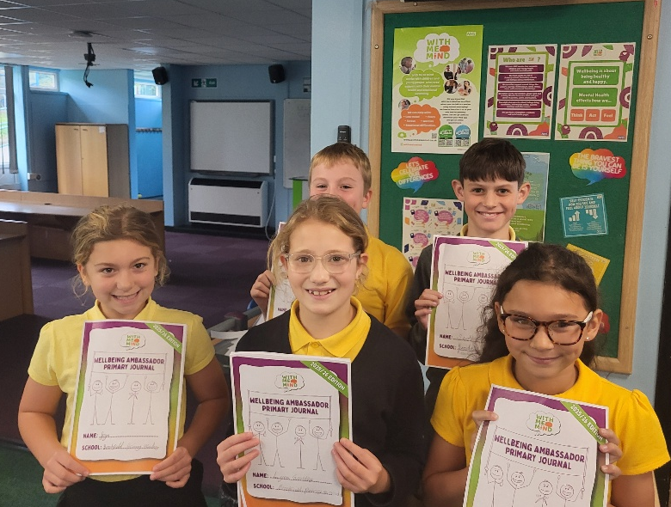
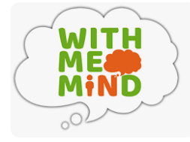

With Me in Mind
At Brookfield Primary Academy, we are proud to work in partnership with the With Me in Mind team to promote positive mental health and wellbeing across our school community. Through this collaboration, we provide pupils with regular workshops and support sessions that cover all aspects of emotional wellbeing—from building friendships and resilience to managing anxiety and developing self-confidence.
We have a dedicated group of With Me in Mind Ambassadors who help to raise awareness, promote positive mental health messages, and support their peers in making healthy choices. Staff work closely with the With Me in Mind team to identify pupils who may benefit from additional support, ensuring timely and appropriate intervention.
This partnership plays an important role in our whole-school approach to wellbeing, helping every child to feel supported, valued, and empowered to thrive both in and beyond the classroom.

Slide 34
Rotherham Drugs and Alcohol service
At Brookfield Primary Academy, we are committed to equipping our pupils with the knowledge and skills to make safe, responsible choices. As part of our personal development curriculum, we offer a series of workshops for Year 5 and Year 6 pupils focused on drug and alcohol awareness.
Delivered over a five-week period by the Rotherham Drug and Alcohol Awareness Team, these sessions provide age-appropriate education on the risks associated with substance use, the importance of making positive choices, and strategies for staying safe.
In addition, we host a dedicated workshop for parents and carers, also led by the Rotherham Drug and Alcohol Awareness Team, to help them support and guide their children at home. Together, these sessions strengthen the partnership between school and families, ensuring a consistent and informed approach to safeguarding our pupils’ wellbeing.

Slide 35

Swinton Academy – our Feeder school
At Brookfield Primary Academy, we are proud to maintain close links with our local feeder school, Swinton Academy. This partnership provides a wide range of opportunities for our pupils to engage in academic, creative, and sporting experiences that support their personal development.
Pupils frequently visit Swinton Academy for sporting tournaments, drama performances, science activities such as heart dissections, and Christmas craft workshops. Swinton pupils also support Brookfield by helping to run our Sports Day and stalls at our Christmas and Summer Fairs, fostering a sense of community and collaboration.
To support a smooth transition to secondary school, Year 5 pupils participate in three activity days at Swinton Academy, while Year 6 pupils take part in two dedicated transition days and multiple workshops with the transition leads. These experiences help our pupils build confidence, independence, and readiness for the next stage of their education.

Slide 36
Breakfast Club
Brookfield Primary Academy offers a Breakfast Club to provide a safe, welcoming, and supportive start to the school day for all pupils. The club ensures that children begin their day with a nutritious meal, giving them the energy and focus needed to engage fully in learning.
Benefits for Children:
Healthy Start: Access to a nutritious breakfast supports physical health, concentration, and overall wellbeing.
Improved Learning Readiness: Pupils arrive alert, focused, and prepared to participate in lessons.
Social Development: Children have the opportunity to interact with peers in a relaxed environment, building friendships and social skills.

Slide 37
Breakfast Club
Benefits for Children:
Routine and Structure: Provides a consistent start to the day, helping children settle into the school day calmly and positively.
Supportive Environment: Staff offer pastoral support, encouraging positive behaviour, confidence, and emotional wellbeing.
Overall, the Breakfast Club contributes to children’s academic, social, and emotional development, ensuring they start each day ready to learn and thrive.

Slide 38

After – School Clubs
Brookfield Primary Academy offers a variety of after school clubs to enrich pupils’ learning experiences, develop new skills, and provide opportunities for social interaction. Clubs are run by school staff as well as external providers (some of which may have a small associated cost), ensuring a broad and engaging range of activities for all interests.
Examples of Clubs Offered:
Academic and creative clubs: Science Club, Computing Club, Art Club, Card Club
Sports and physical activity: Football, Gymnastics, Cheerleading
Performance and music: Young Voices

Slide 39
After – School Clubs
Benefits for Children:
Skill Development: Pupils can explore new interests, develop talents, and build confidence in specific areas.
Social Opportunities: Children interact with peers across different year groups, forming friendships and teamwork skills.
Physical and Mental Wellbeing: Sports and physical activities promote health, fitness, and emotional wellbeing.
Enhanced Learning: Clubs complement classroom learning and inspire curiosity, creativity, and engagement.
Personal Growth: Pupils develop resilience, independence, and a sense of achievement through participation and performance.
By offering a wide range of clubs, Brookfield Primary Academy ensures that every child has the opportunity to pursue their passions, try new experiences, and grow as a well-rounded individual.

Slide 40


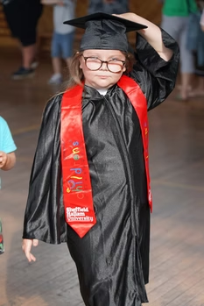
Children's University
Brookfield Primary Academy is proud to work in partnership with Children’s University, celebrating and recognising our pupils' commitment to extra curricular learning. Through their dedication, many of our children have achieved Bronze, Silver, and Gold awards, culminating in a formal graduation celebration. We are incredibly proud of their achievements and the enthusiasm they show for learning beyond the classroom.

Slide 41

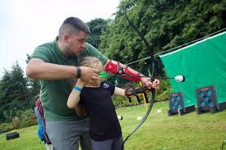
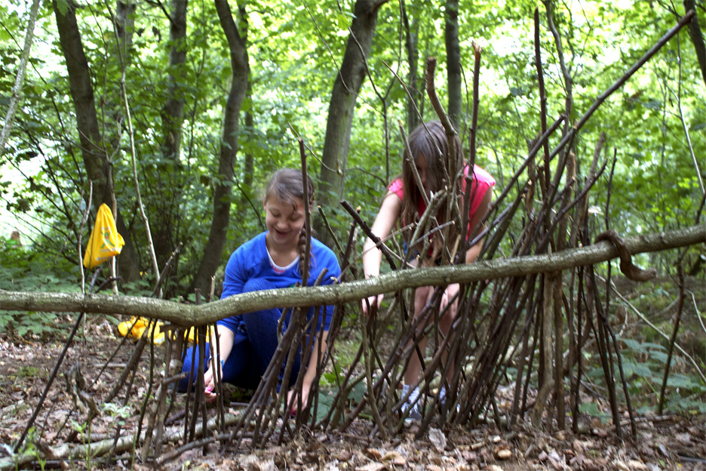
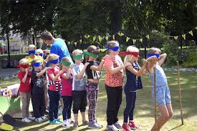
After – School Clubs
Wrap-around care is available through an external provider, POPS Adventure Camp at Rawmarsh. They offer safe and engaging childcare until 6:00 PM, including convenient collection from school via minibus. This service provides a fun, supervised environment for children after school, giving parents peace of mind and flexible care options.

